Slide 1
Cyber Security Awareness
Campaign Plan 2022/23

Slide 2

Cyber Security Awareness
Campaign Objectives
With an ever-evolving threat landscape we find it critical that we develop and align our enterprise to protect ourselves against Cyber threats.
Failing to do so will put our business in severe risk of being compromised with the potential for large manufacturing outages and safety risks for our machine operators.
Individual user awareness training assists us to mitigate many of the key risks by identifying and dealing with threats in a consistent manner.

Slide 3
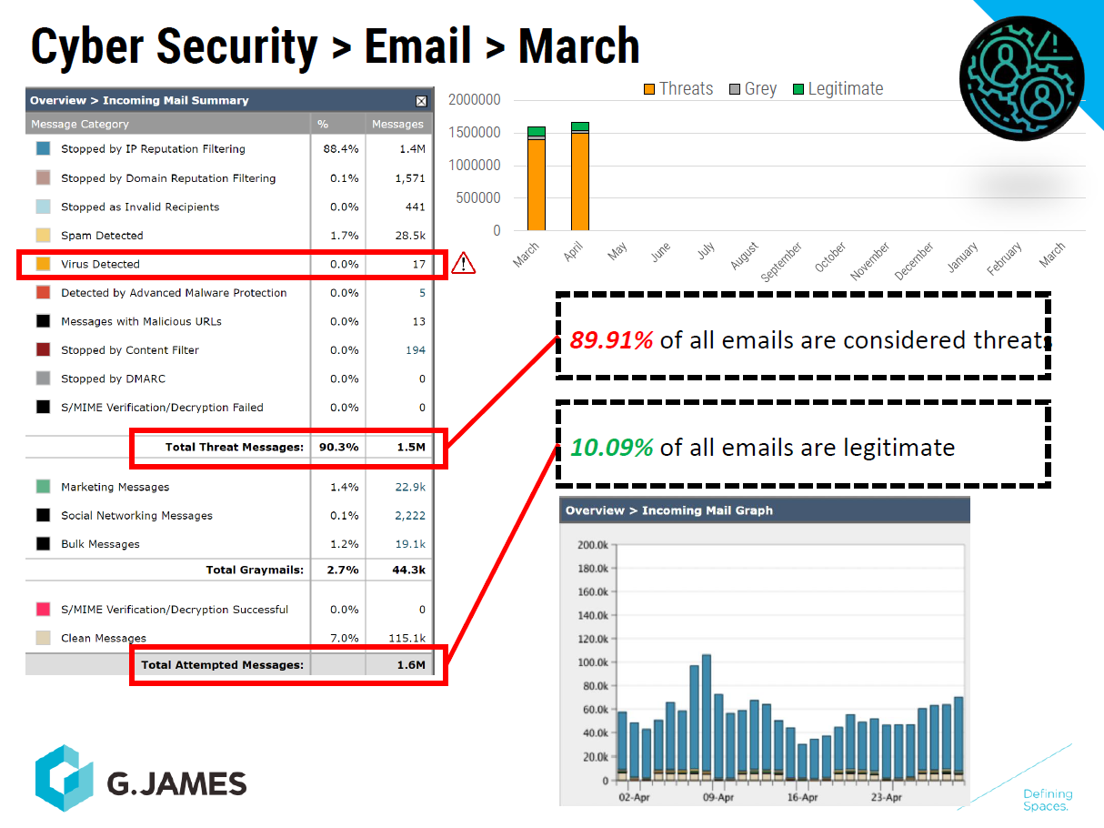
Current Threat levels (March extract)

Slide 4
Cyber Security Awareness Campaign 2022
Commenced November 2022.
Released monthly phishing simulations.
Received well by employees.
Attacks Covered:
Credential harvesting.
Malware dropping.
Training covered:
Email address & URL scrutiny
Email attachment safety.
Email inconsistency red flags.
Training vectors:
Toolbox talks
SharePoint training.
Microsoft tailored training. (Simulation response)

Slide 5
Results 2022
First Simulation:
Abobe licensing credential harvest attack, imitating an application that is used within G.James by most computer users.
33 Users clicked the malicious link.
16 Users supplied credentials.
27 Users completed ‘Mass Market Phishing’ training.
13 Users completed ‘Web Phishing’ training.
Second Simulation:
Netflix account verification, credential harvest.
16 Users clicked the malicious link.
2 Users supplied credentials.
12 Users completed ‘Mass Market Phishing’ training.
1 User completed ‘Web Phishing’ training
Third Simulation: Help desk malware dropper.
13 Users downloaded the Malicious attachment file.
11 Users completed ‘Malware’, ‘Ransomware’ and ‘Phishing Six Clues That Should Raise Your Suspicions’ trainings.

Slide 6
Moving Forward In 2023
Monthly Releases.
Increased detection difficulty.
Reinforce concepts from 2022.
Diversify the Microsoft assigned training.
Attack vectors:
Compromised business partners.
Compromised internal.
External service providers.
Attack types:
Credential harvesting.
Malware attachments.
Malicious URLs.

Slide 7
2023 Q1 Email phishing training ???
Sent Monthly (4 week intervals.)
Email Password reset (Drive by credential harvest)
Email password reset request from ICT Technology manager.
Ques: external banner, spelling, grammatical, URL and domain inconsistencies.
Plays on the fear of a password reset.
False quote (credential harvest)
Common attack vector for G.James.
Email from false client with a remittance or quote that is gated behind a log in.
Log in captures credentials.
Ques: external banner, URL, landing page, common practice inconsistencies.
Fake PDF attachment. (Malware dropper)
Common attack vector for G.James.
Email from false client with a remittance or quote that is in html file disguised as a PDF.
Fake PDF is malware that is downloaded and ran by user.
Ques: external banner, unsolicited email, attachment inconsistencies.

Slide 8
January 2023
Attack: Drive-by URL
This simulation will depict a compromised / impersonated IT account.
The situation for the user: Email implies that the users password is about to change and they must click a link to keep it.
The situation for the attacker: The user follows the link and adds their credentials which the attacker now has.
Ques:
Users will have the external banner to indicate that the email may be deceptive.
Users should be able to identify that this process is not standard business practice.
Users should be able to spot irregularities with the URL.
Users should be able to spot irregularities with Email and Signature.
Users should spot grammatical inconsistencies.

Slide 9
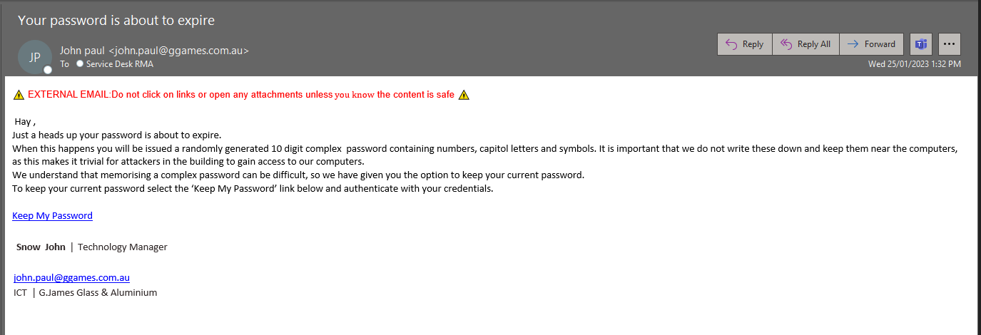
January 2023 email

Slide 10
January
Results
Emails sent: 1808
Emails Deleted: 554
Emails Read: 554
Users Compromised: 58
Training completion (30/1): 31%

Slide 11
February 2023
Credential Harvest
This simulation will replicate a fictitious actor sharing a fake document that has a duplicate Microsoft login.
These attacks a fairly common, attacker attempts to have the target sign in to view the document. The sign in procedure steals the credentials.
Ques:
Users will have the external banner to indicate that the email may be deceptive.
Users should know not to trust URL links.
Users should be able to spot irregularities with the URL.
Users should note that the sender is not known to them, email is unsolicited.

Slide 12
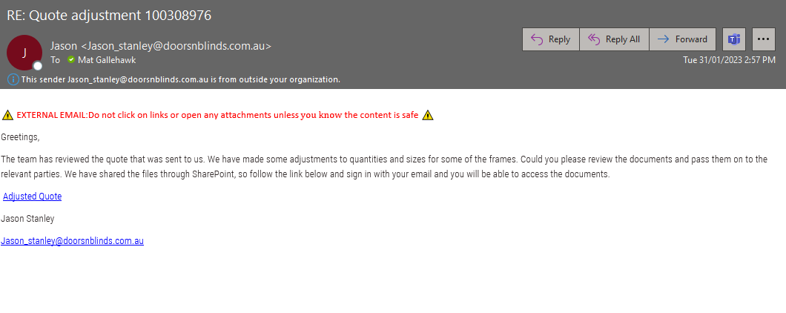
February 2023 email

Slide 13
March 2023
Malware drop.
Malicious attachment.
Html file disguised as pdf quote or purchase order.
Increasingly common attack. (INC0035981 & INC0035977 2/02/ 23)
Ques:
Users will have the external banner to indicate that the email may be deceptive.
Users should note that the sender is not known to them, email is unsolicited.
Users should be able to know the difference between a pdf and html attachment.

Slide 14
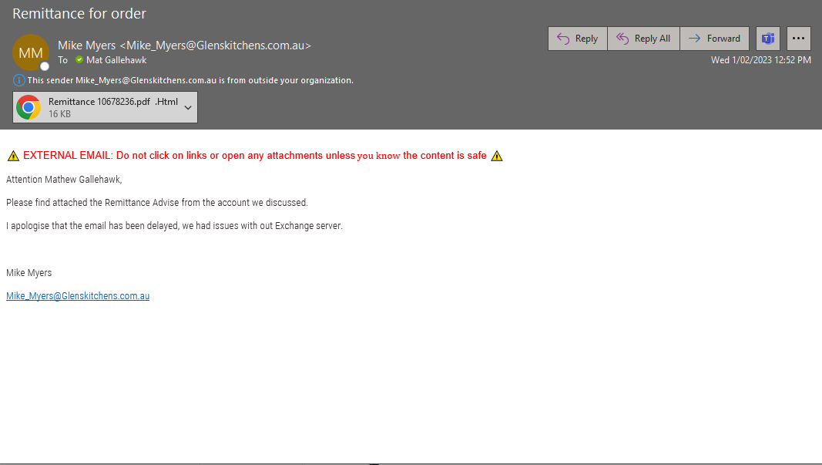
March 2023 email

